Slide 1
CAR POOLING SYSTEM

Slide 2
Team – Car Pooling System
Arihant Jain (Scrum Master)
Aishwarya Natarajan
Anjali Chachlani
Charmi Valecha
Jitesh Wadhwani
Harini Ramesh
Mithun Vasanth
Pratik Jagtap
Pratiksha Patil
Siddharth Shah
Sowmya Selvaraj

Slide 3
Agenda
To build a project in a way that is better than existing systems.
To include the features like different types of trips.
To use agile methodology for development of project.
To learn and use Maven, Hibernate, Spring MVC, Bootstrap , Angular JS.

Slide 4
Introduction
Carpooling has become a practical, cheap and stress-free way to move around.
The added features, compared to available applications are :
Different kinds of trips :
Regular trips
Frequent trips

Slide 5
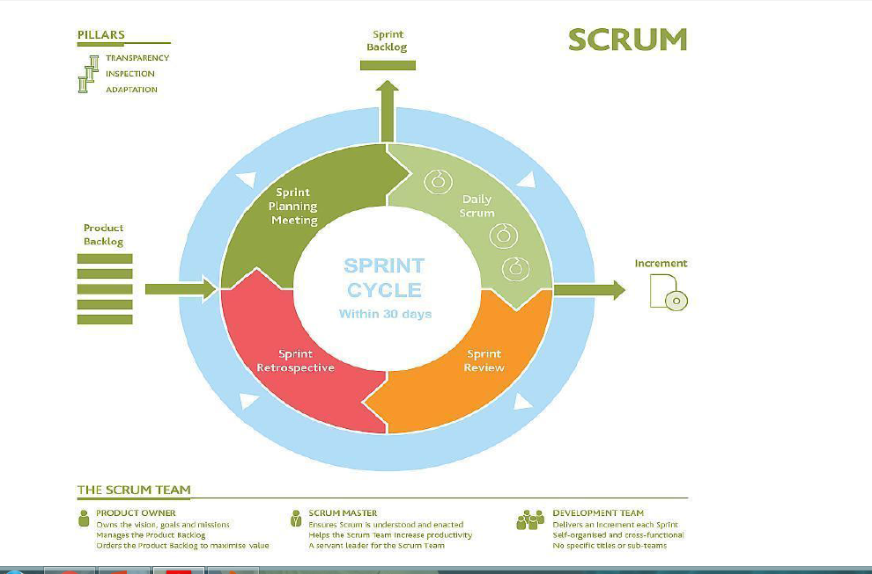
AGILE

Slide 6
The entire project will follow the Agile methodology, SCRUM to be precise.
• Well Defined Product Backlog
• Structured Sprints with Timelines
Sprint Initiation and Planning
Sprint Daily Meeting
Sprint Review Meeting
Sprint Retrospective Meeting

Slide 7
Functional Requirements
Registration - where new users can register themselves.
Login - that allows registered users to log in and create trips or register for trips.
Search trip - gives the choice to either search a regular or frequent trip.
Create trip - gives the choice to either create a regular or frequent trip.
Rate user - shows all the users that the user has taken a trip with. Then it gives him the ability to rate those users.

Slide 8
Non-Functional Requirements
Browser compatibility :-
The application will be compatible with all browsers which support JavaScript.
Performance Requirements :-
The performance requirements for this application need to be bench marked as per the user requirements.
Security :-
User gets OTP on e-mail for registering into the system.

Slide 9
Modules
Registration and Login Module :
User should be able to register and login to the system.
To generate unique id for new user account.
Login credentials must be verified.
Update user profile Module :
Allow users to see his/her existing information.
Allow registered users to update his/her profile.
To check that only valid information is added.

Slide 10
Modules (Continued…)
Create trip Module :-
To generate unique trip id for every new trip.
Driver will create trip.
Driver have to provide the preferences.
Meeting point Module :-
Driver will have to fix the meeting point.
Multiple meeting points can be decided depending on the driver’s choice.

Slide 11
Modules (Continued…)
Search for trip Module :-
To search a trip based on source, destination, type.
To search according to the preferences of the passenger (AC/NON-AC, Smoking, Luggage, etc.)
Join trip Module :-
Passengers will be selecting their start and end location of journey.

Slide 12
Modules (Continued…)
Seat availability and cancelling :-
Passengers can book any number of seats from the available options.
Rating :-
Driver will rate passengers who are associated with him.
Sharing of trip on social media :-
Users can share their trip on social media.
Sharing is done only by authorized users.

Slide 13
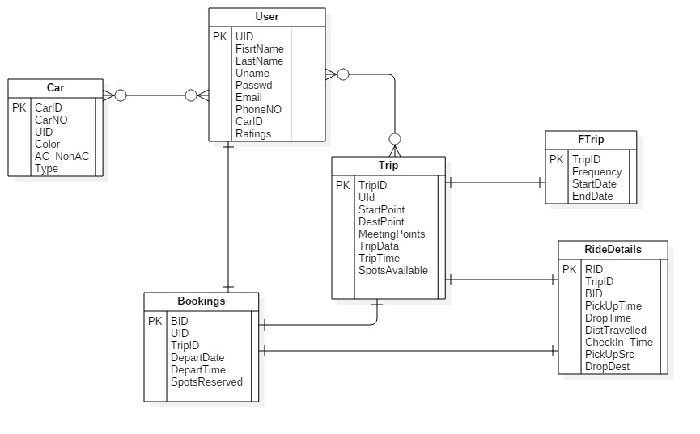
ER Diagram (Before)

Slide 14
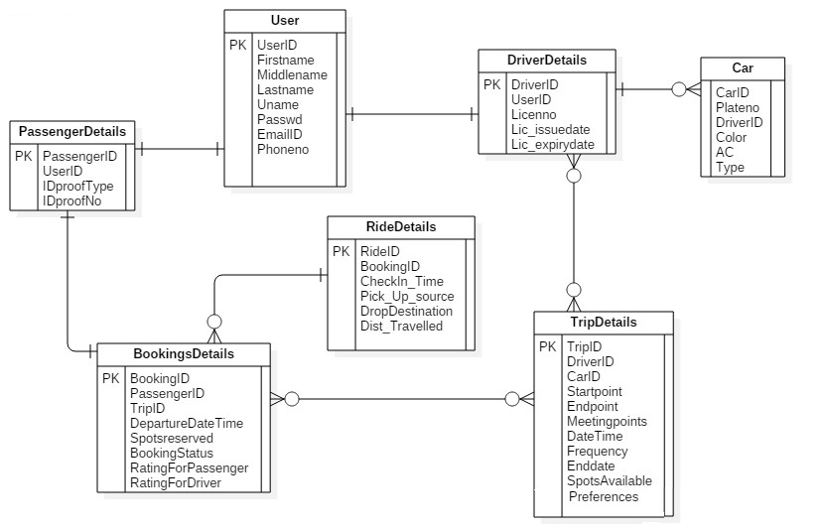
ER Diagram (Modified)

Slide 15
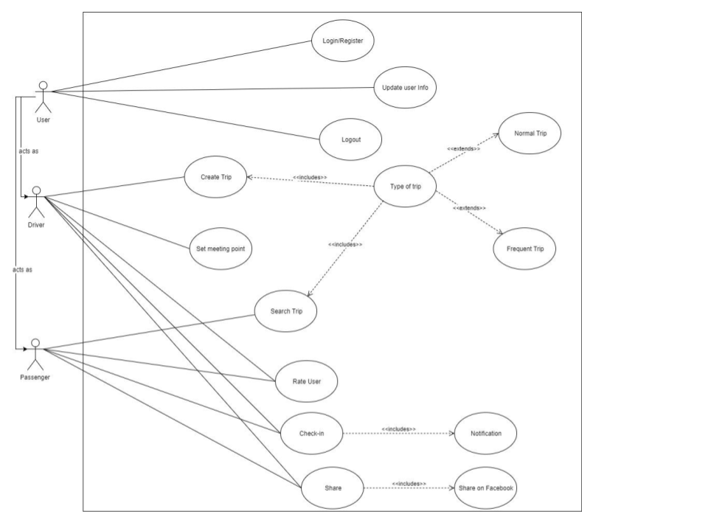
Use case diagram

Slide 16
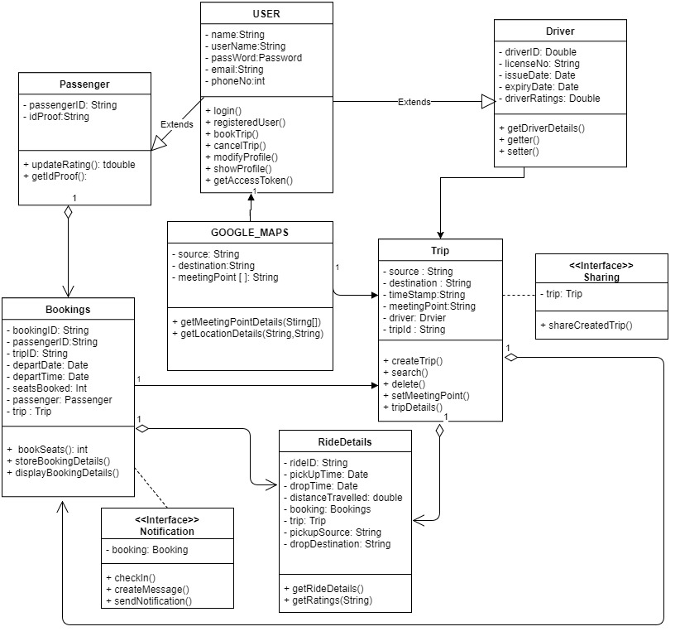
Class Diagram

Slide 17
The Tech Stack
Server Side | Client Side
JSP/ Servlet | HTML 5, CSS
Hibernate | Bootstrap
MySQL database | Javascript

Slide 18
IDE and other Tools
Tools | Software
Java IDE | Eclipse
Web Server | Apache Tomcat 8.5 Server
Database | MySQL

Slide 19
Future Scope
Google maps can be used extensively for personalized maps and locations.
Location can be incorporated with the current application with more features.
Adding custom exceptions.
Bookings and trips can be analysed and personalized for each user.
A feature for top rated users can be added.

Slide 20
Thank You…!!

